Slide 1





System Analysis & Design
GROUP PROJECT Presentation
STUDENT NAME | MATRIX NUMBER
ABDULRAHMAN SIAD TIFOW | A23MJ3061
LING SIEW SIEW | A23MJ5060
HASSAN SAAD AHMED | A23MJ3005

Slide 2
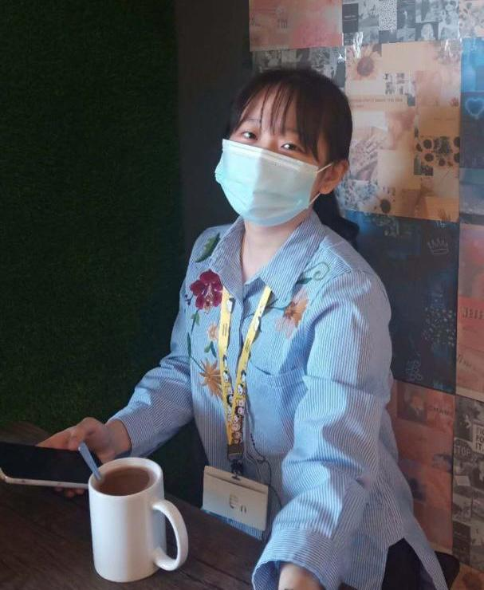


Team Members
Abdulrahaman Siad Tifow
Ling Siew Siew
Hassan Saad Ahmed

Slide 3



Introduction of the System
Quiz-quiz is an online quiz platform that contains various subjects of different levels.
A lecturer-student based system.
The platform is accessible 24/7 (Always).
Mobile App or visit via website.

Slide 4




Problems/ Challenges Faced by the Users
Difficulty in finding appropriate aims.
No time to find or prepare quizzes by students or lecturers.
Difficulty in marking or finding correct answers.
Lack of practice or perfect in a particular part.

Slide 5






Benefits & OBJECTIVES OF THE system
Time-saving & Cost-effectiveness
Easy creation
Flexibility learning
{work anytime, anywhere)
Immediate feedback & maintenance
Scalability
(holds much users)

Slide 6
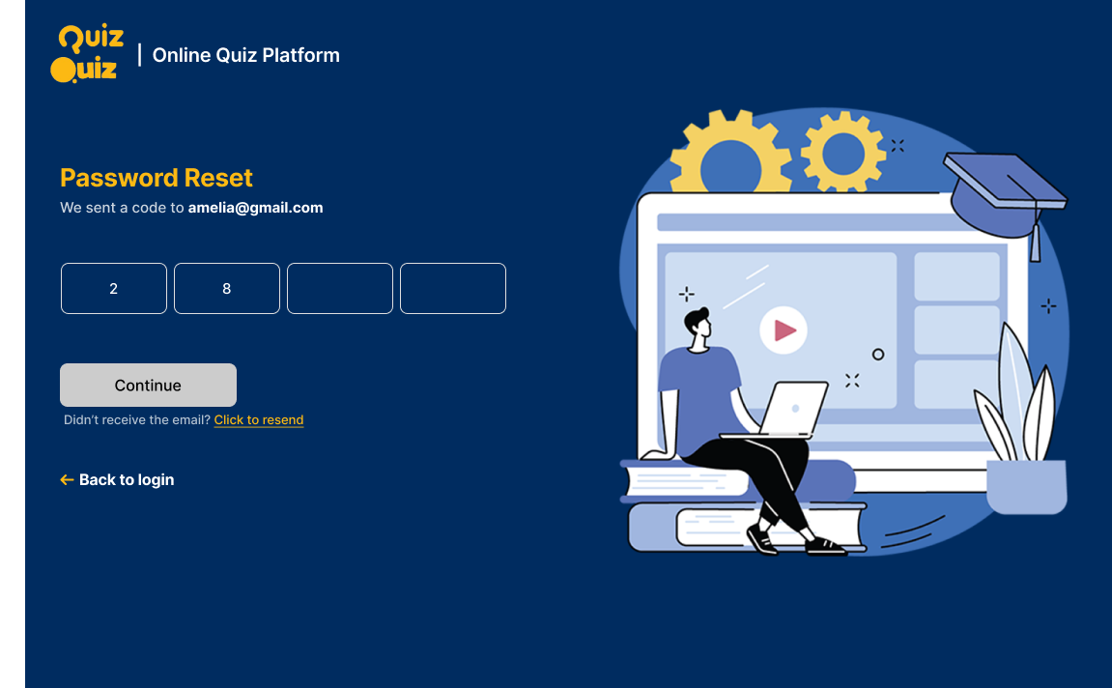
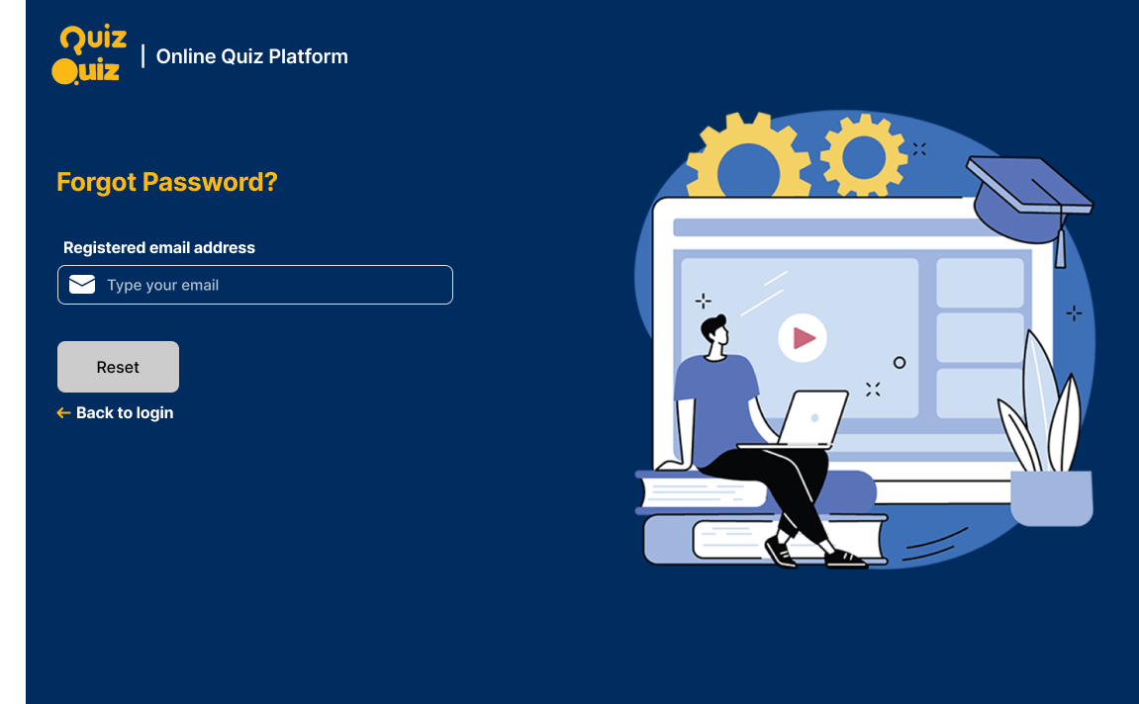
Sample Prototype
codeverify
Forgot password

Slide 7
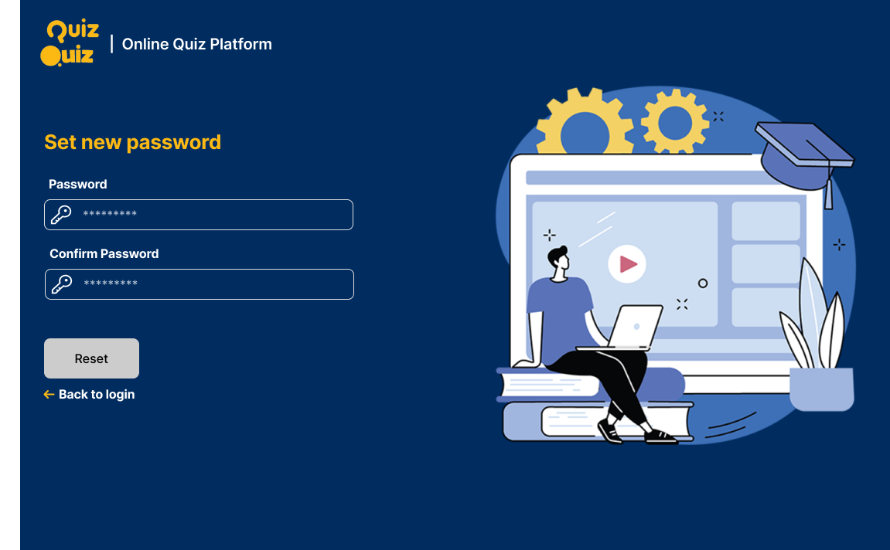
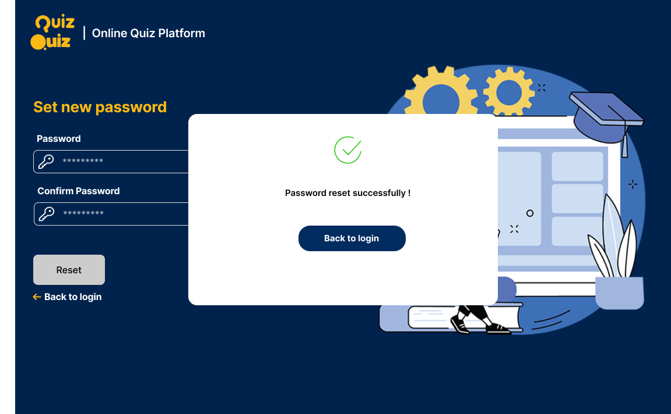
Sample Prototype
resetpassword
resetsuccess

Slide 8
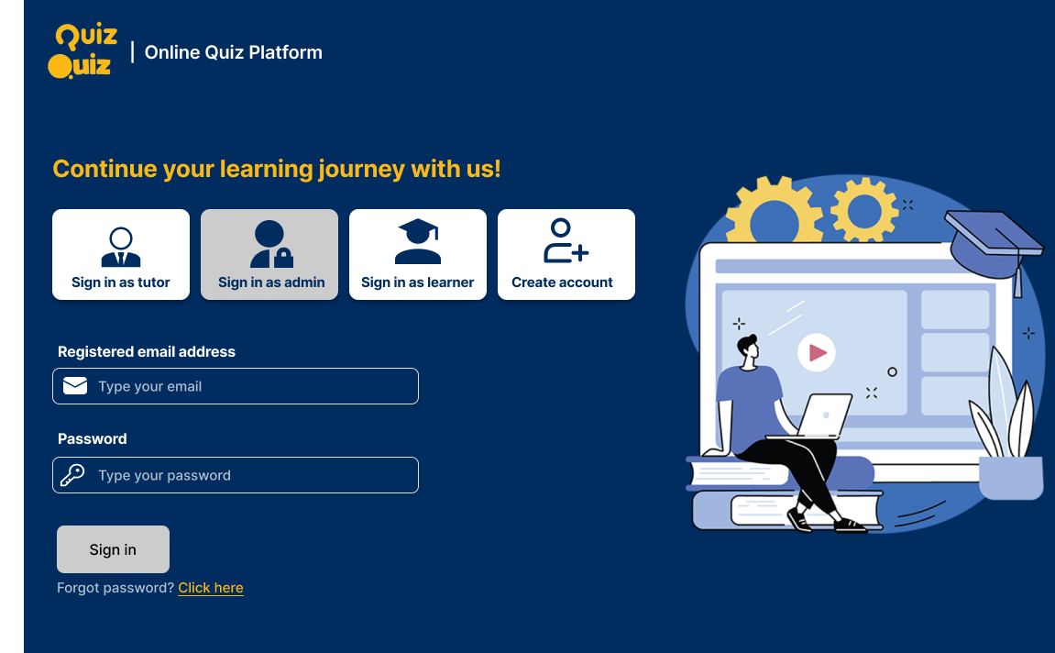
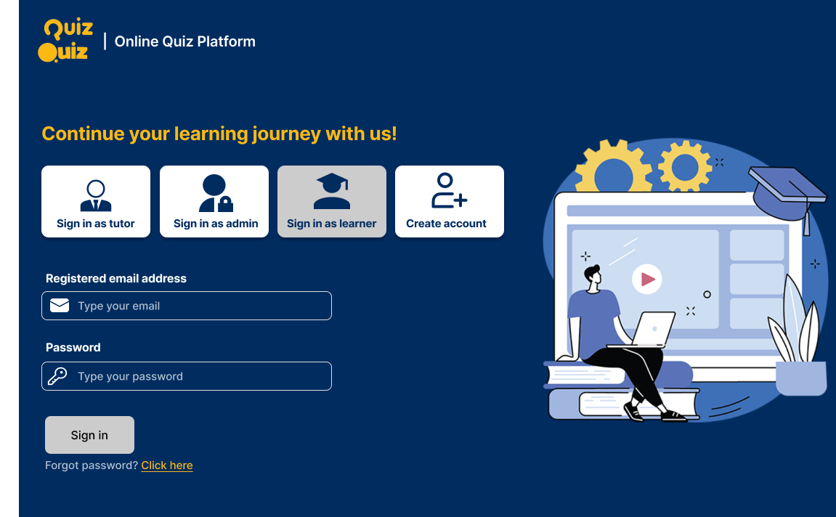
Sample Prototype
Signinadmin
Signinlearner

Slide 9
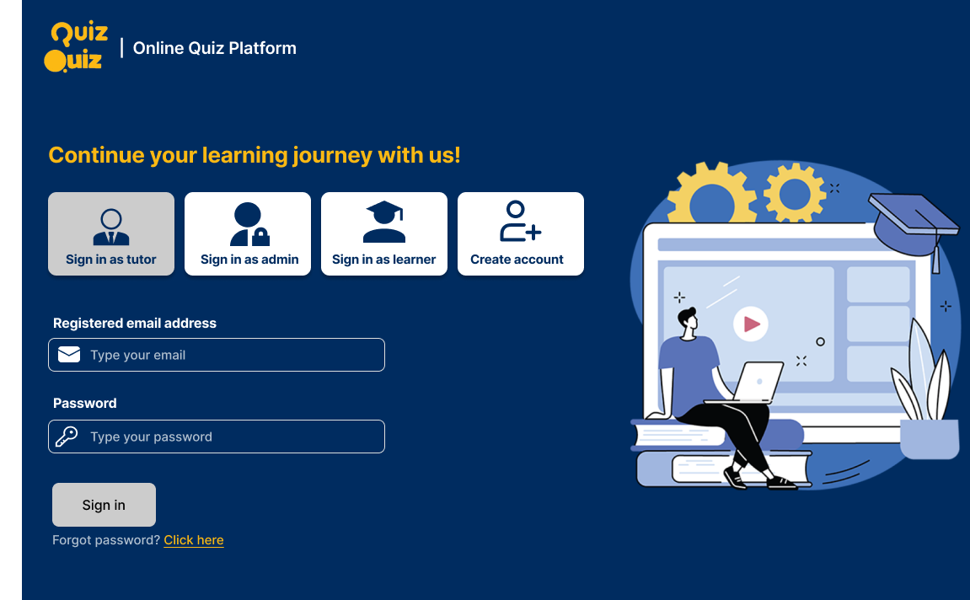
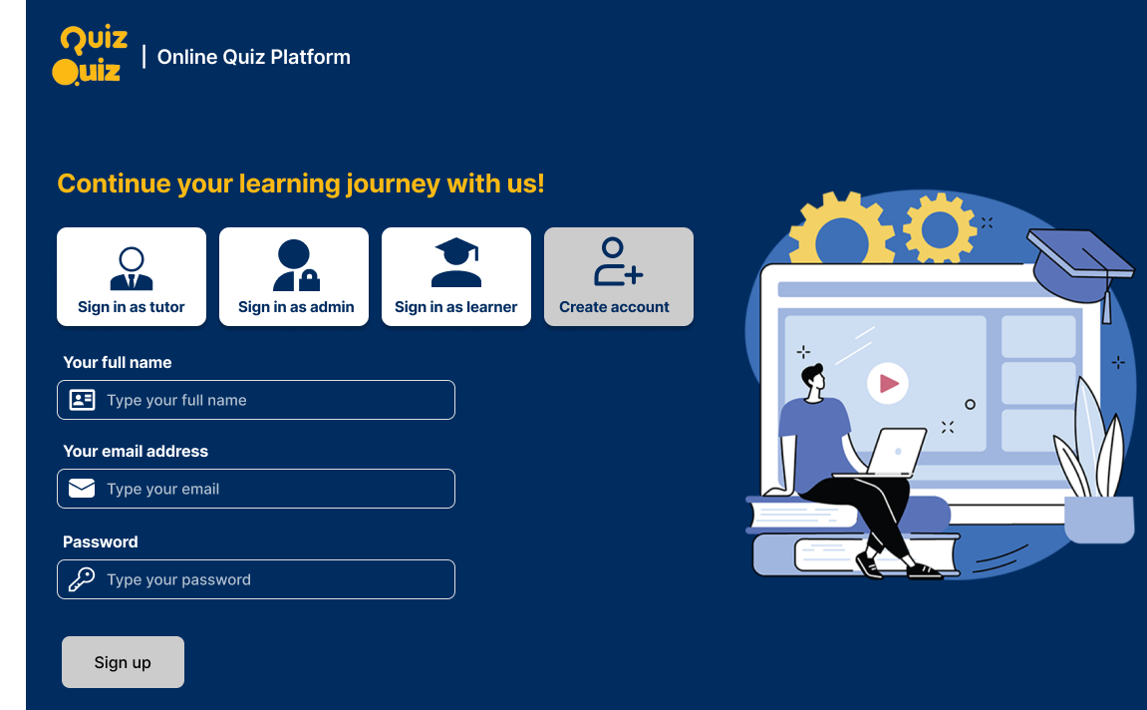
Sample Prototype
Signintutor
Signup

Slide 10

Conclusions
Online quiz platforms allow users to participate from anywhere, anytime.
The interactive features and multimedia involved in the platform make learning enjoyable.
Instant results and analytics help users identify strengths and weaknesses.
These platforms easily accommodate large numbers of users and offer customization options.
This Photo by Unknown Author is licensed under CC BY-SA-NC

Slide 11
Thank You…

